Slide 1
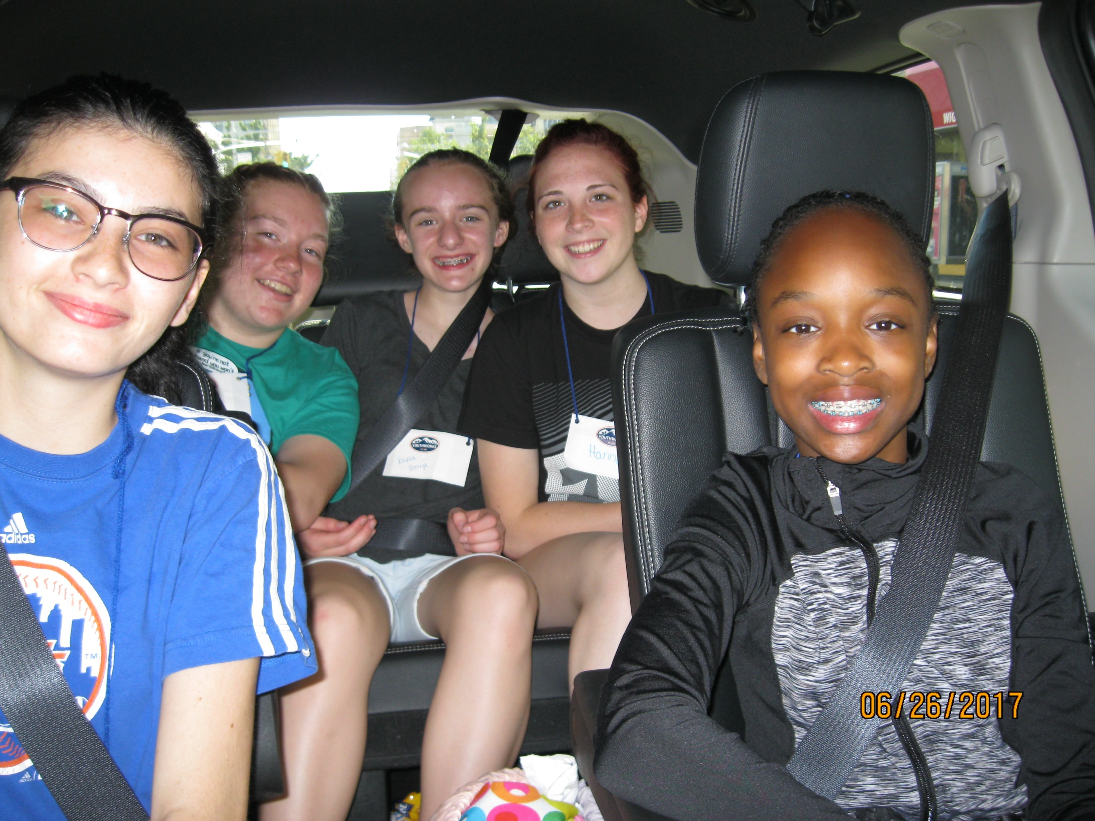

Slide 2
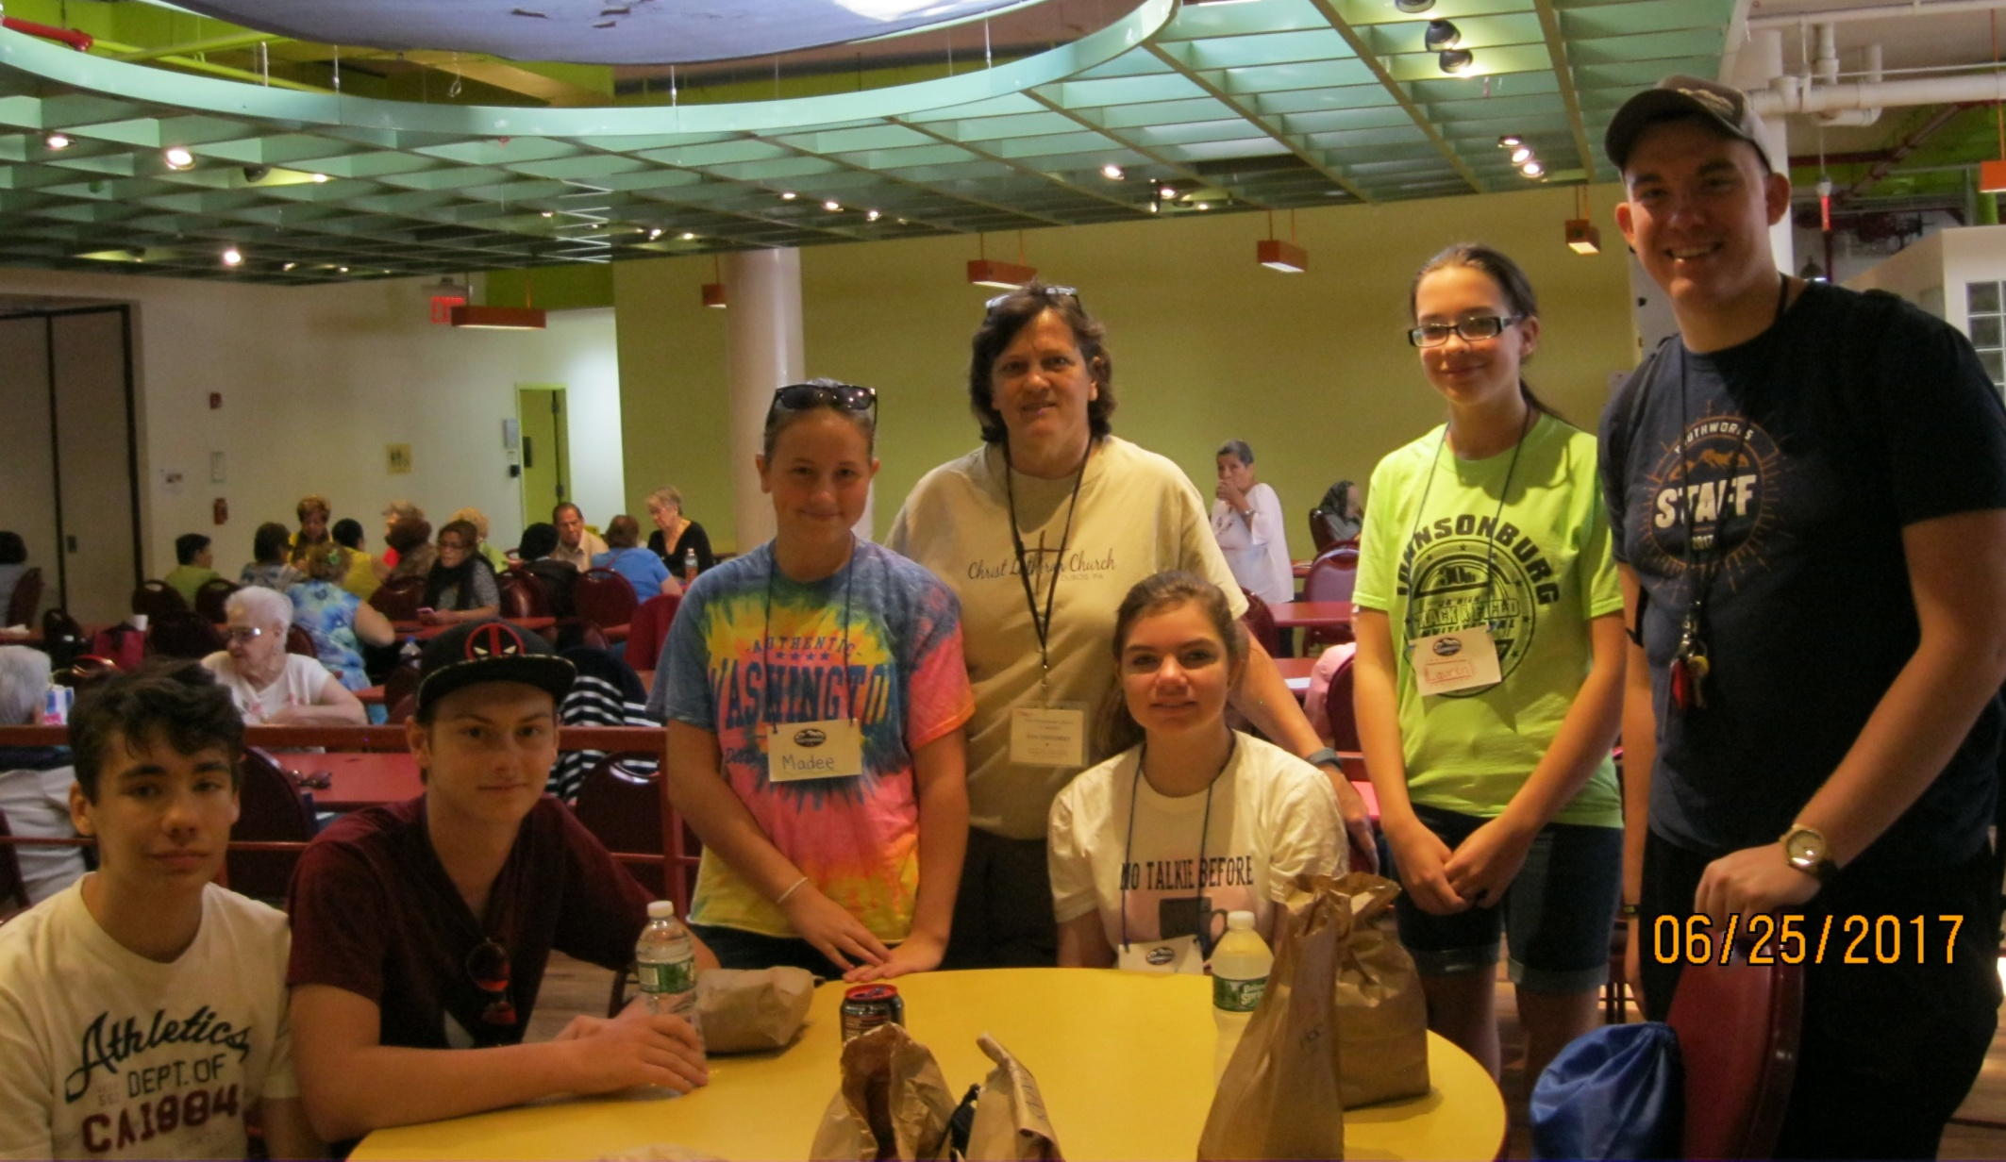
QUEEN WU WORK CREW
Deb, Amanda, Frank,
Dylan, Madee and Lauren

Slide 3
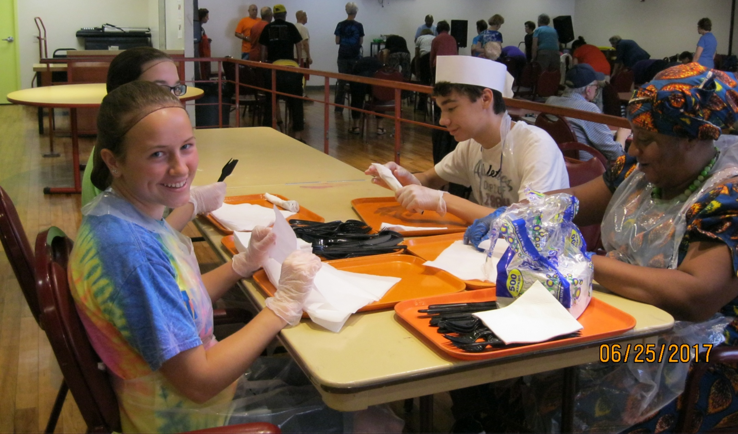
Work at the
Sunnyside Community Center

Slide 4
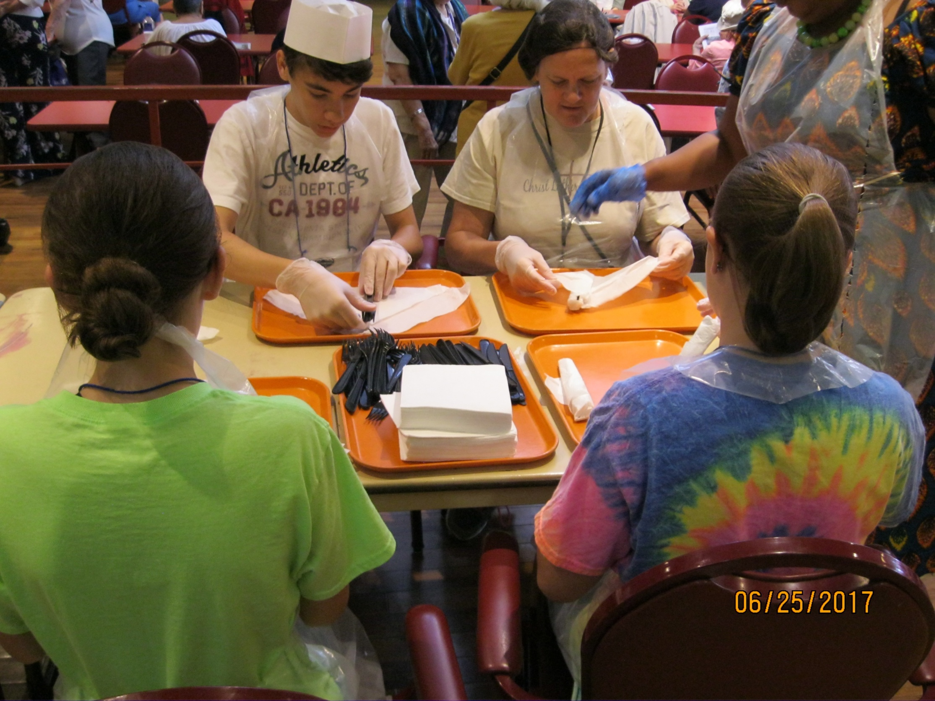

Slide 5
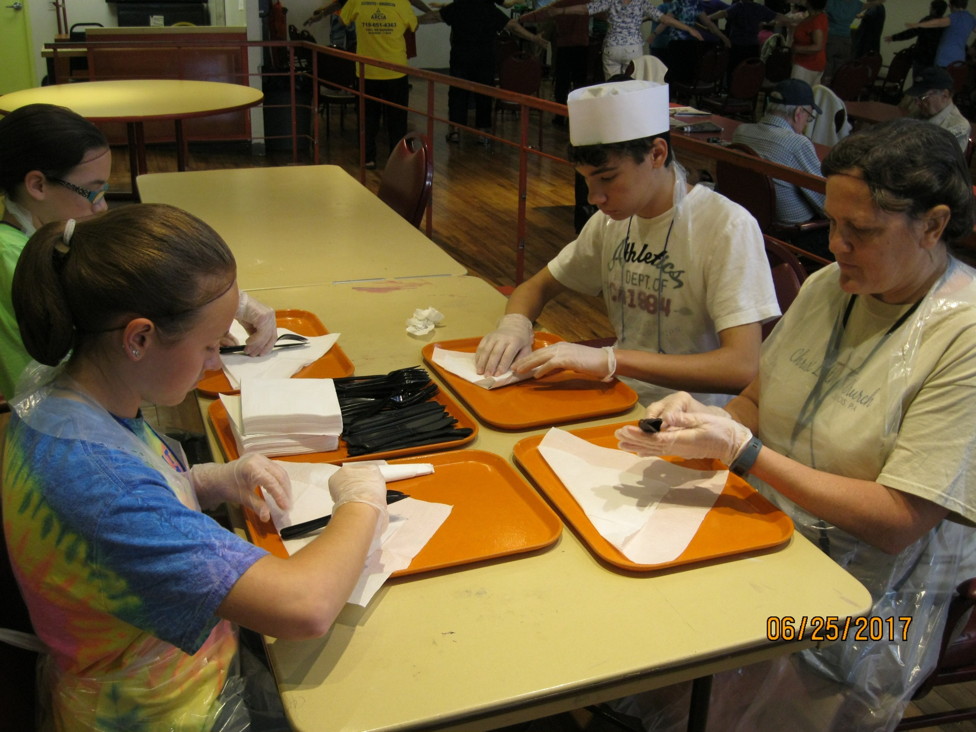

Slide 6
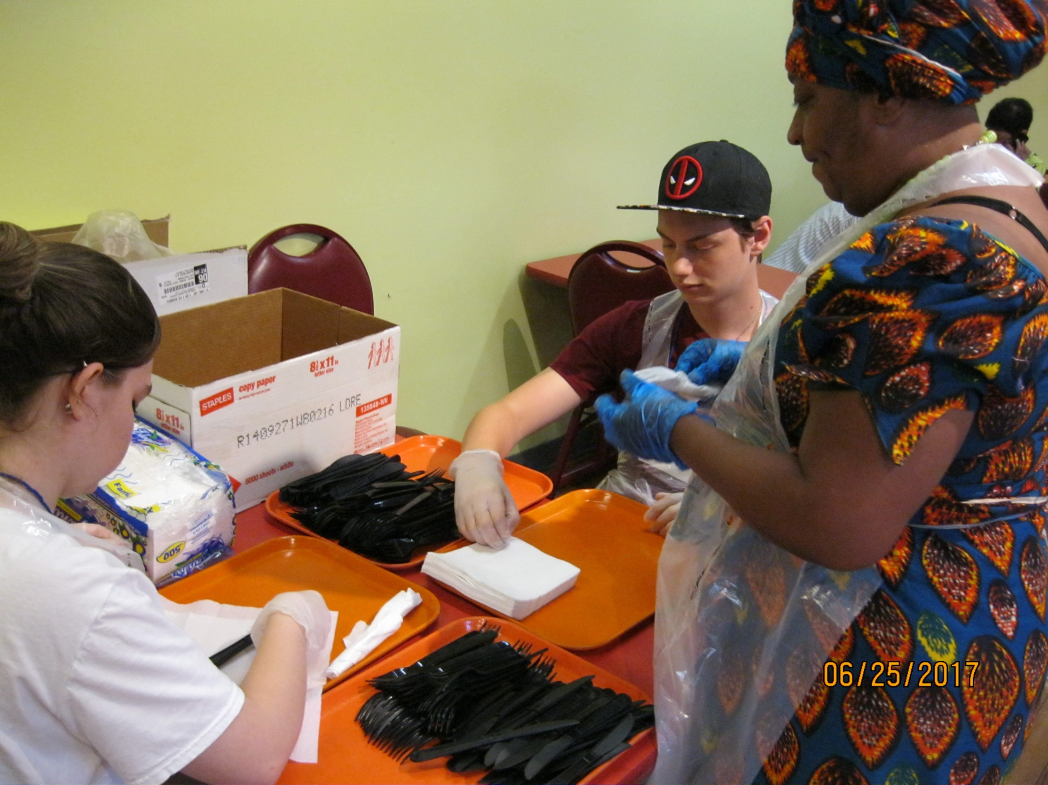

Slide 7
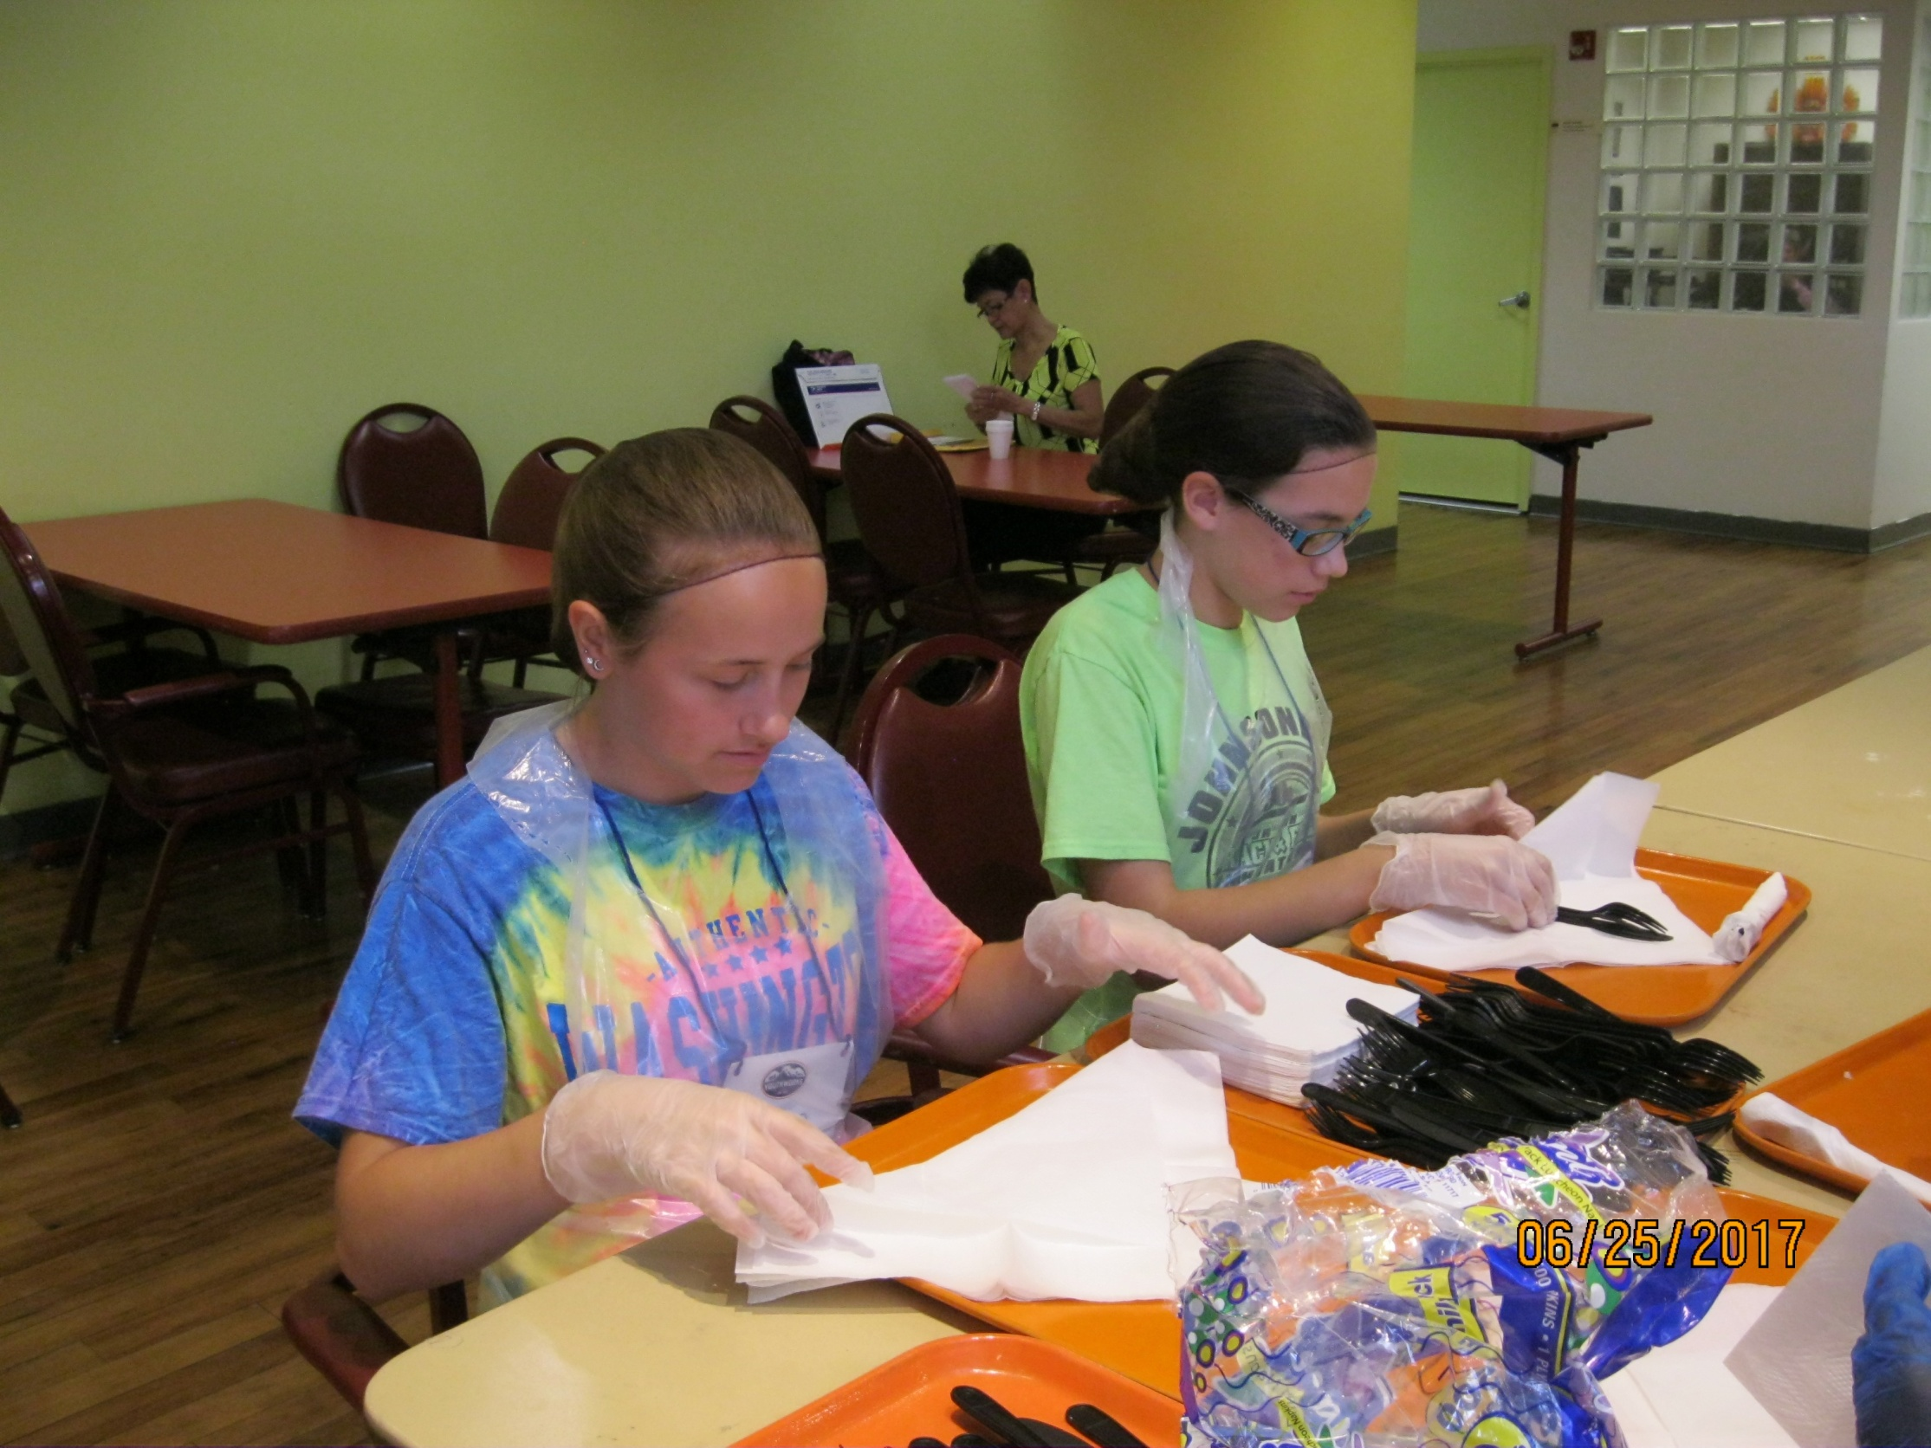

Slide 8
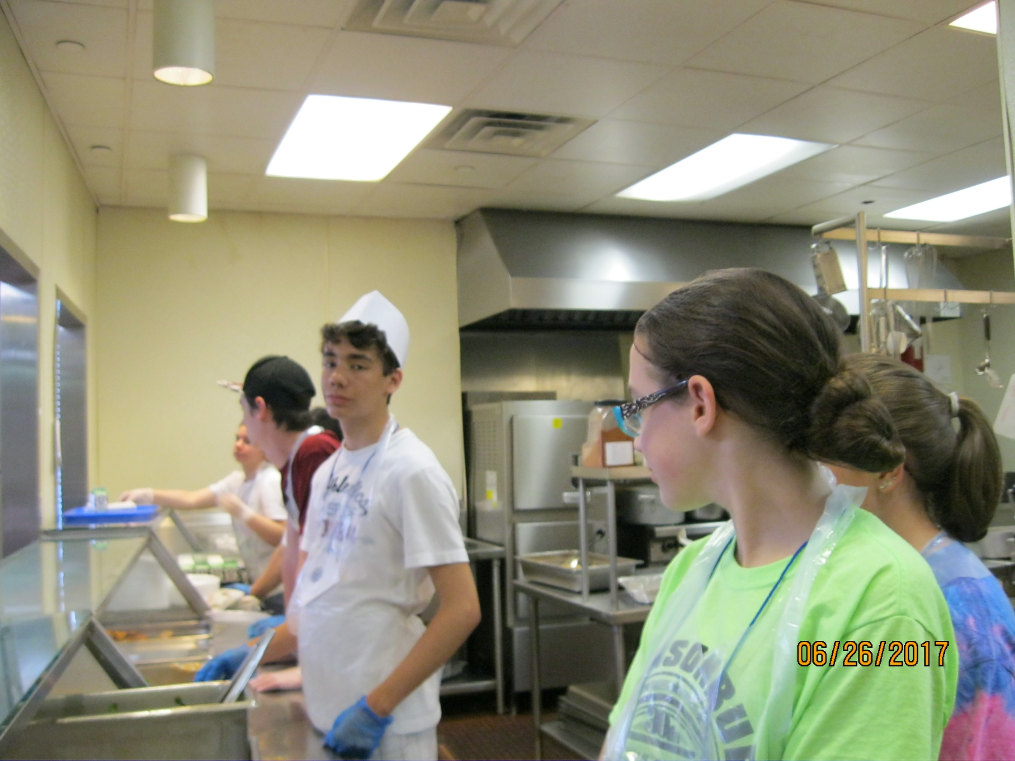

Slide 9
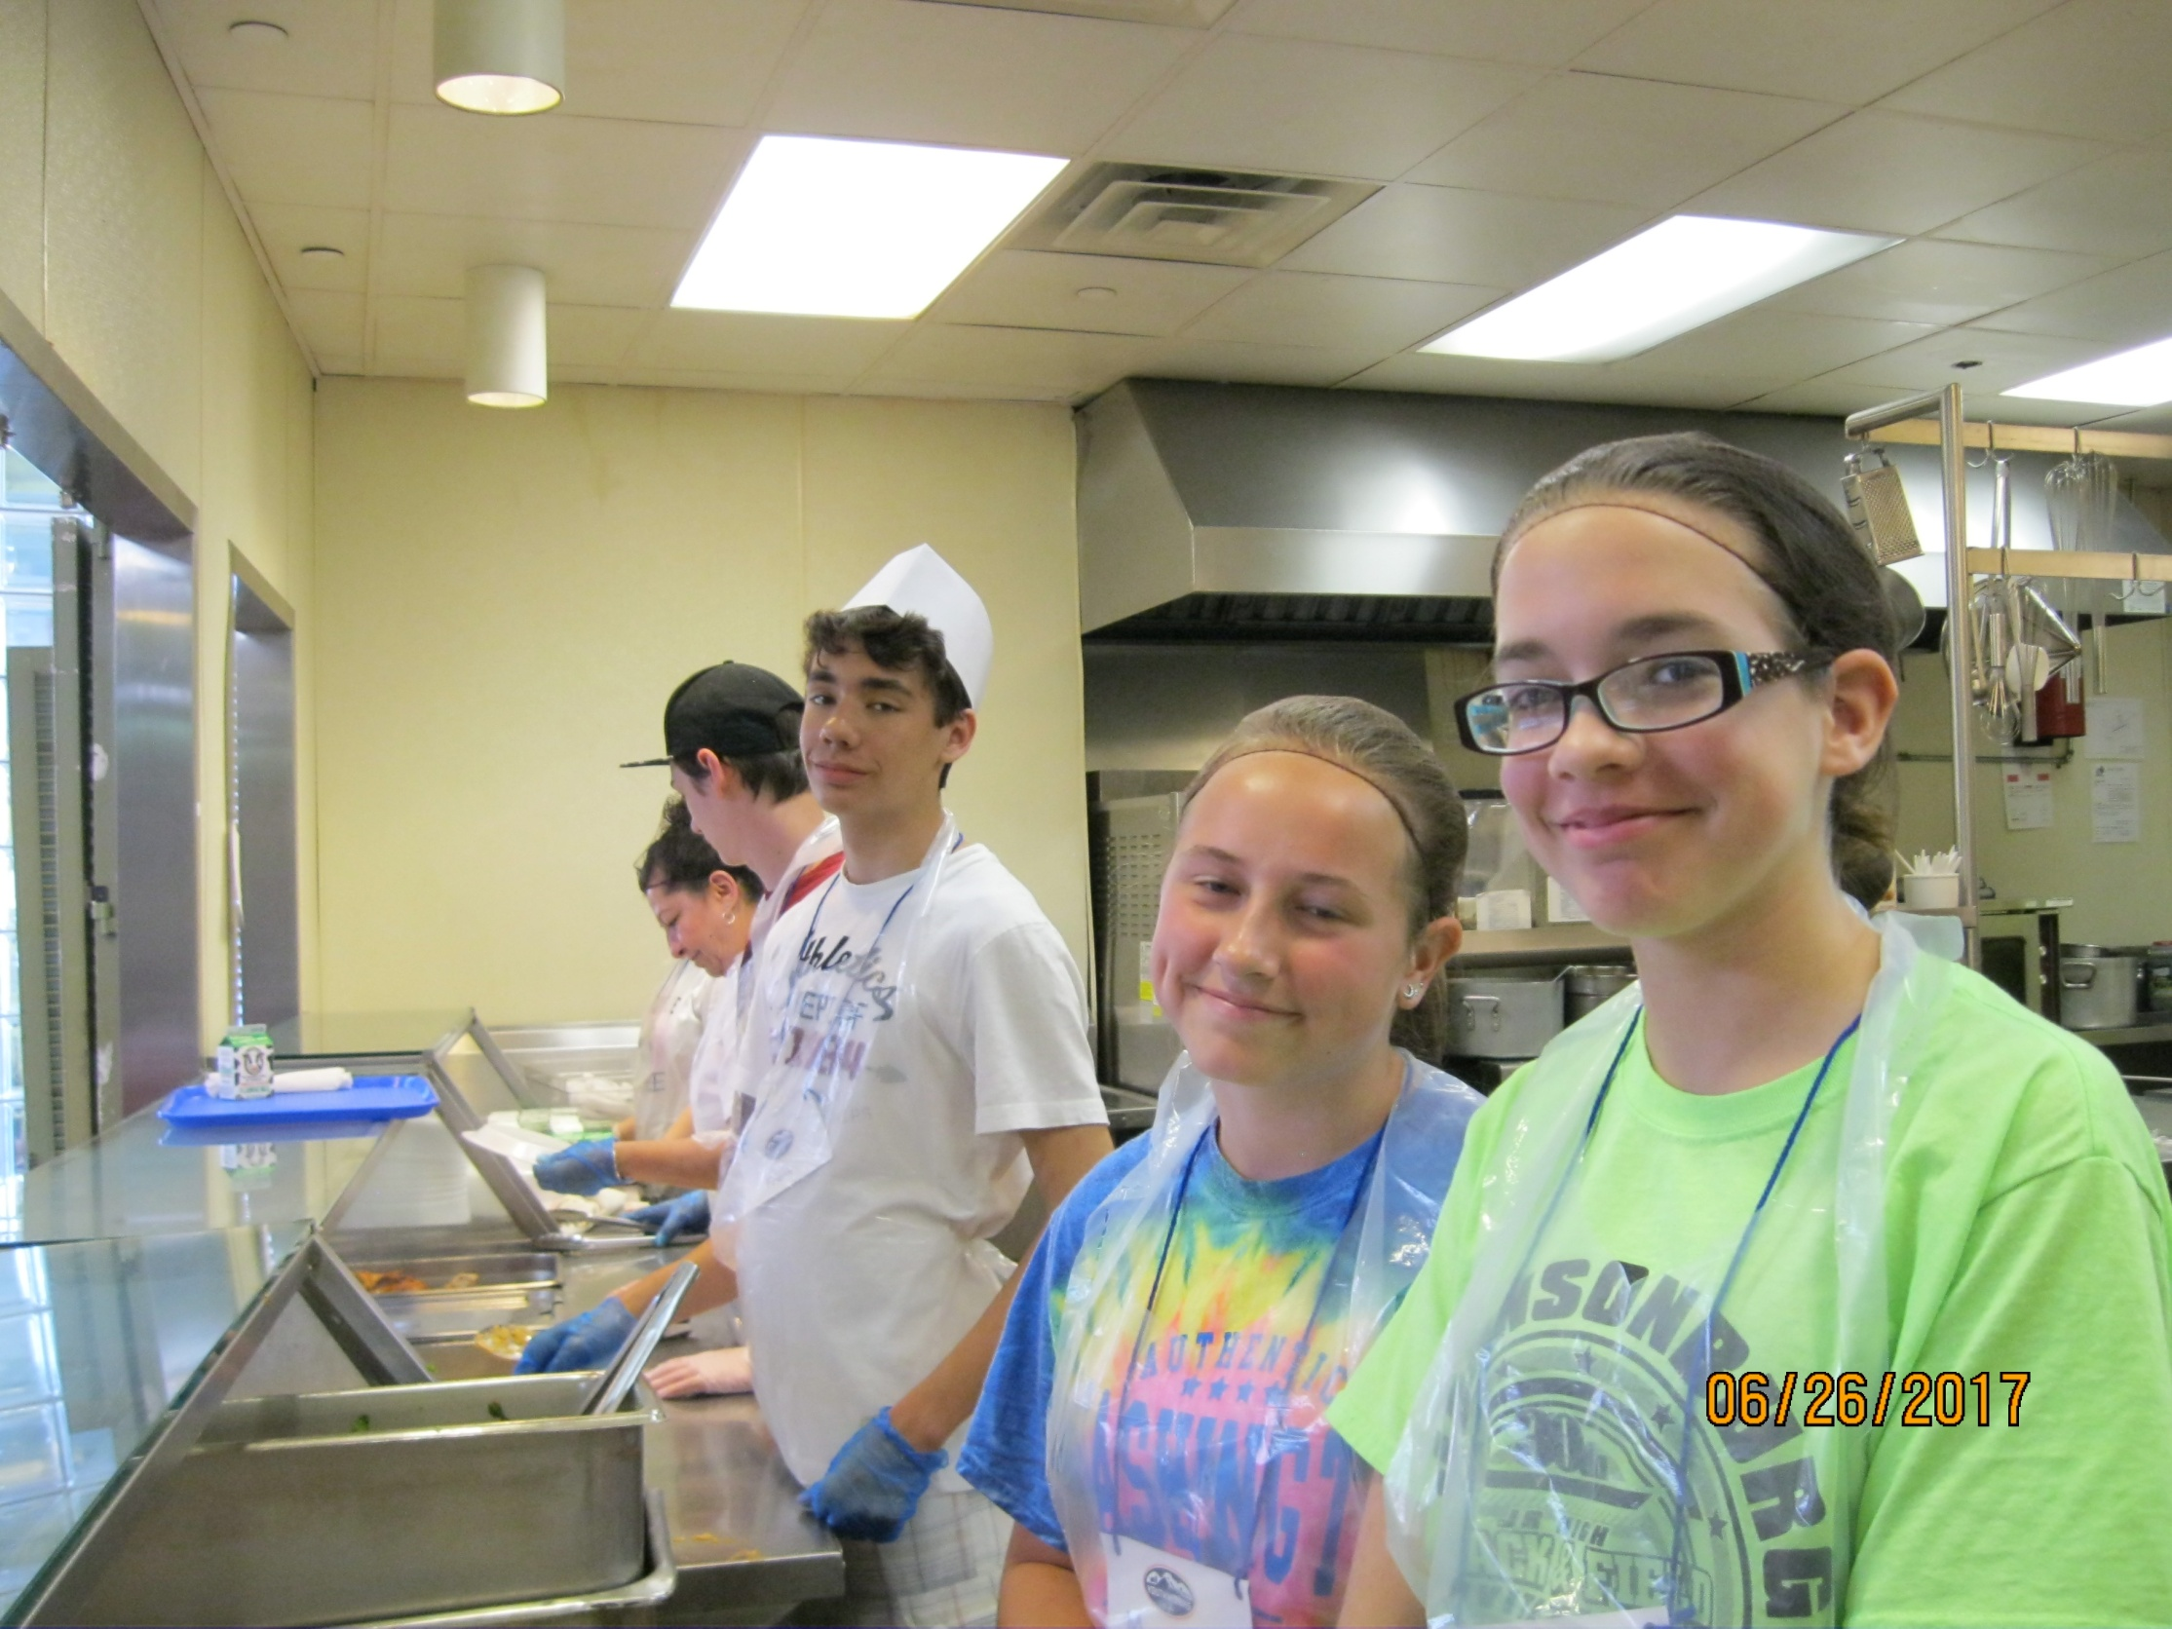

Slide 10
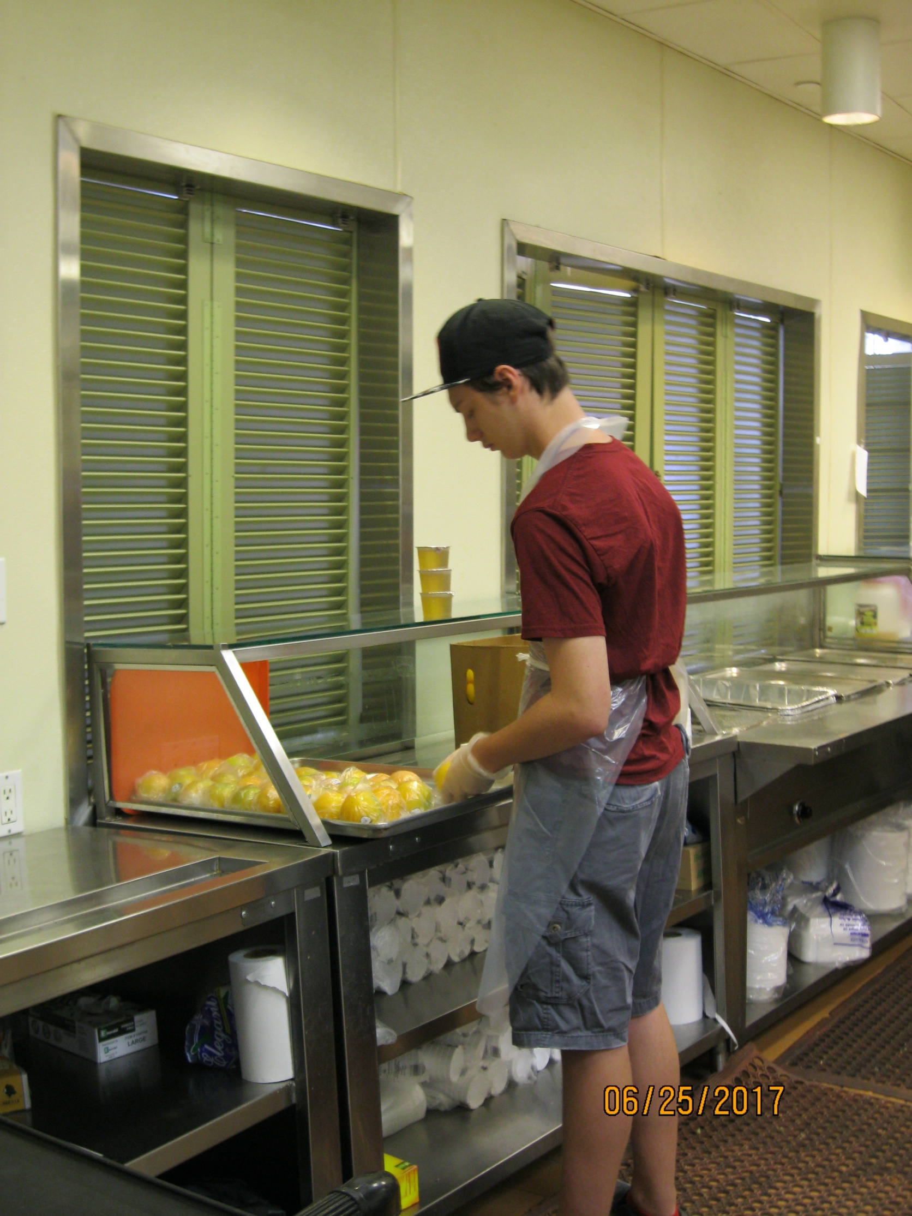

Slide 11
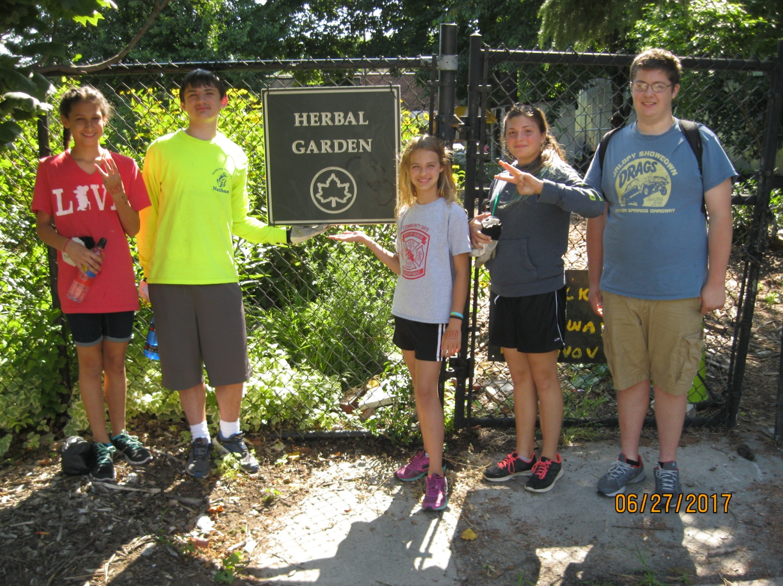
QUEEN ELSA WORK CREW
Steve, Vinnie, Nathan,
Kamryn, Carson and Ali

Slide 12
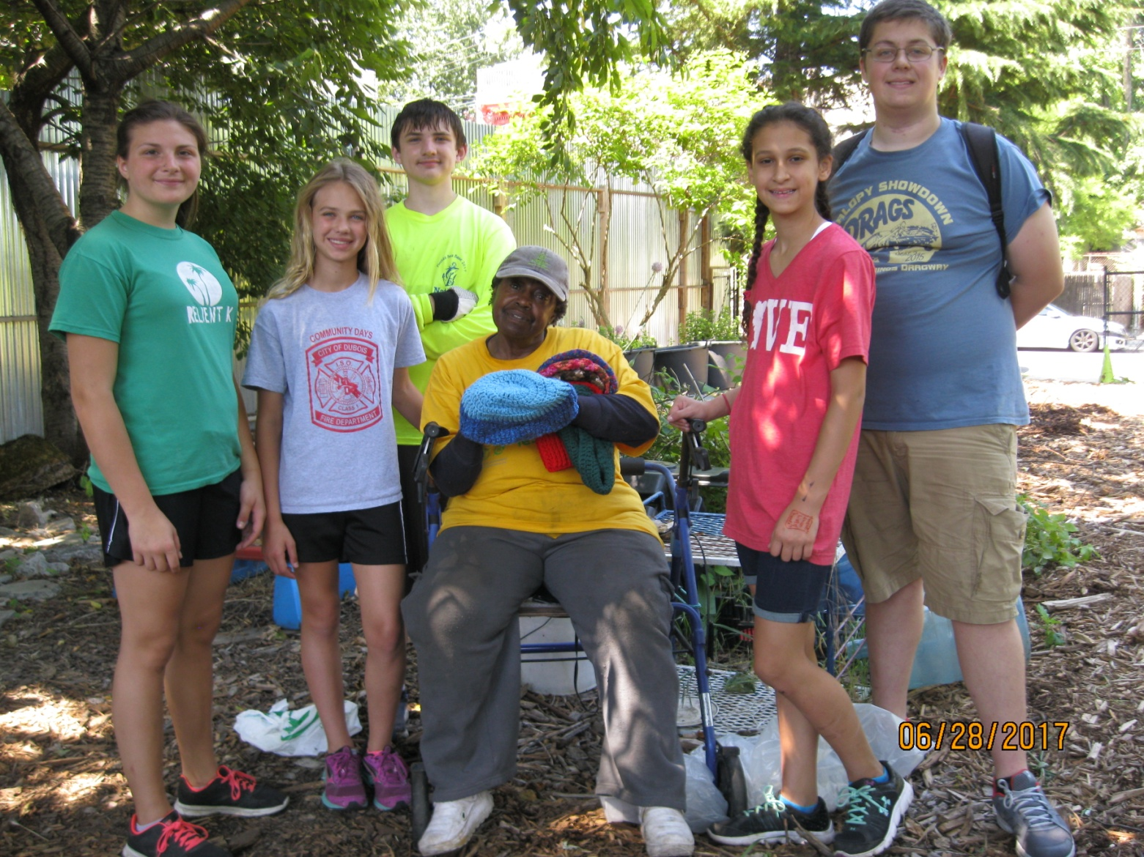
Work at the
The Herb Garden with Miss Johanna
and at an Assisted Living Facility

Slide 13
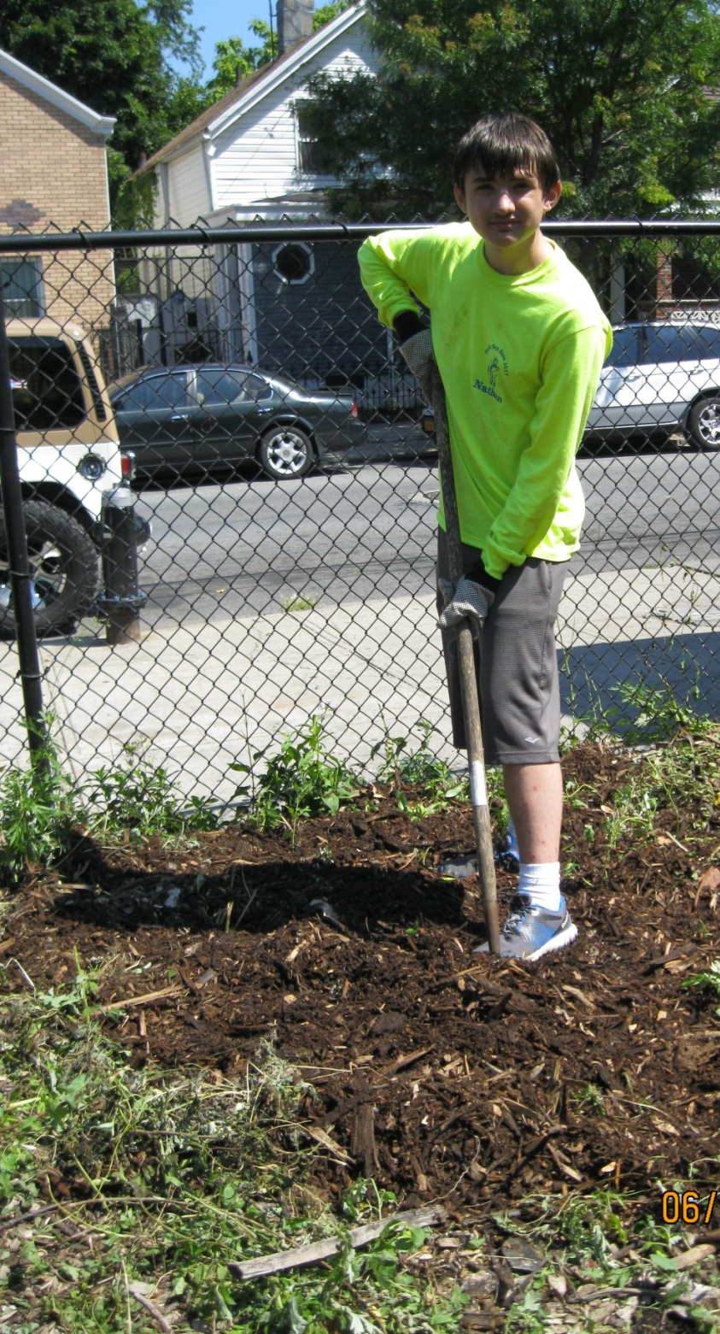
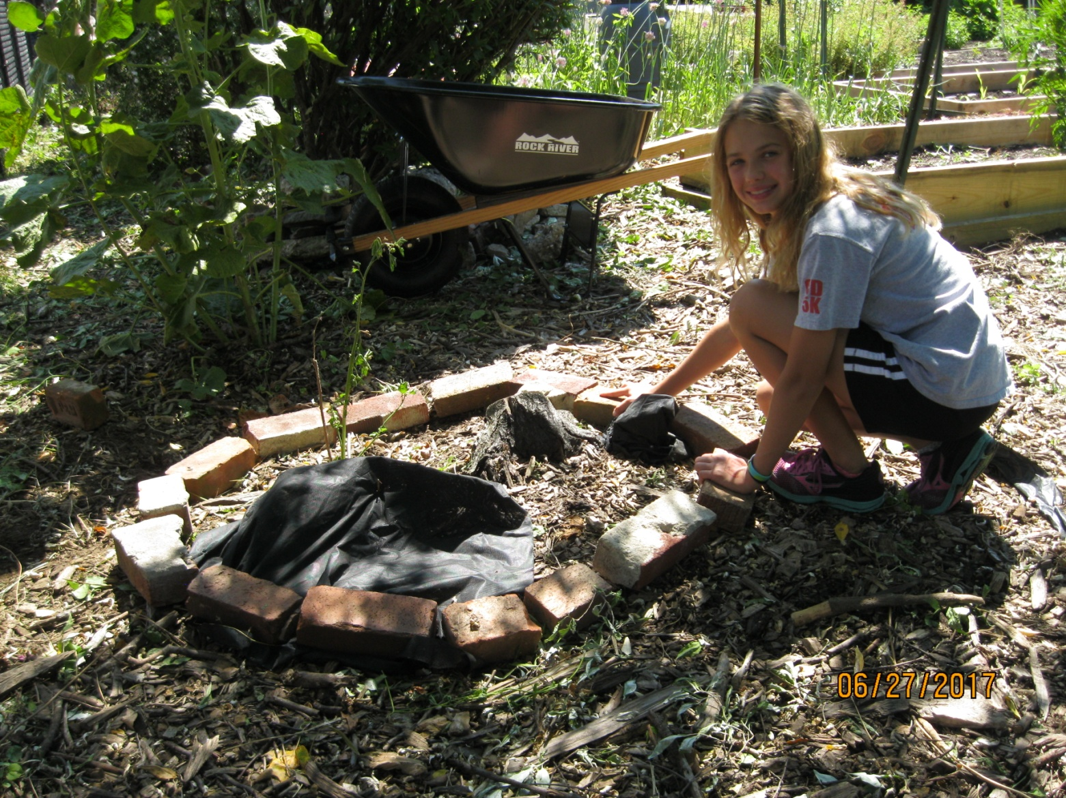

Slide 14
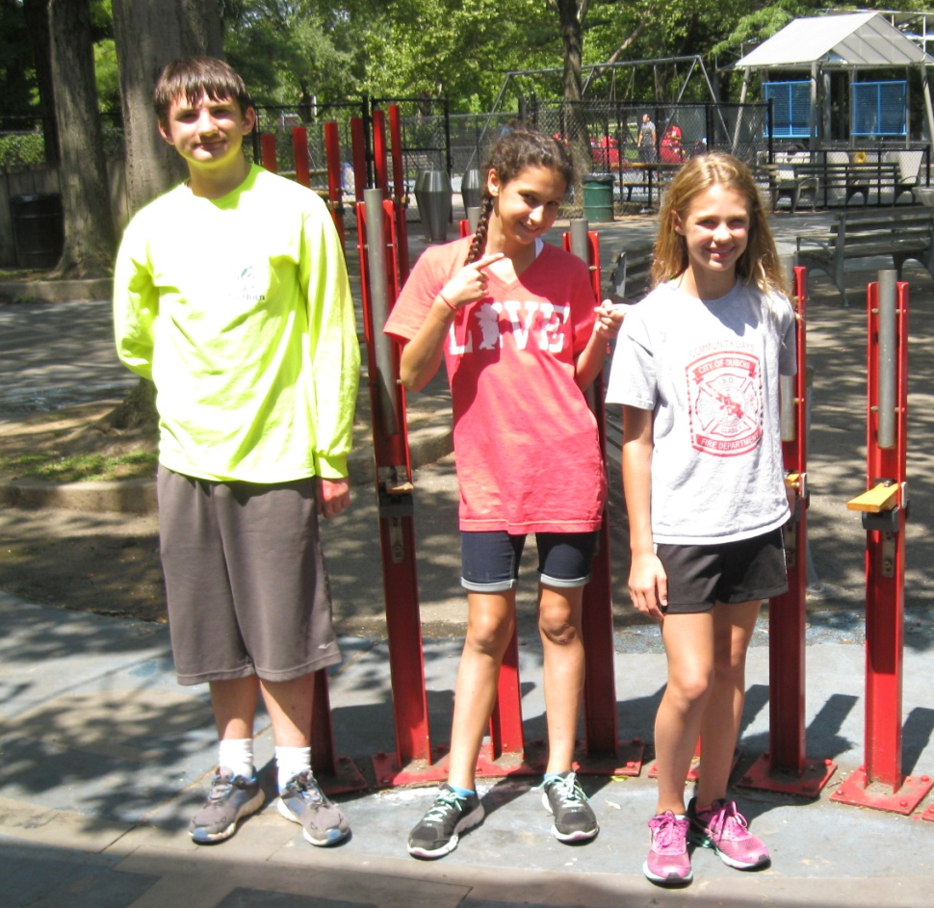
Carson, a friend
of Kamryn,
joined our group for the week.
She lives in Mississippi!

Slide 16
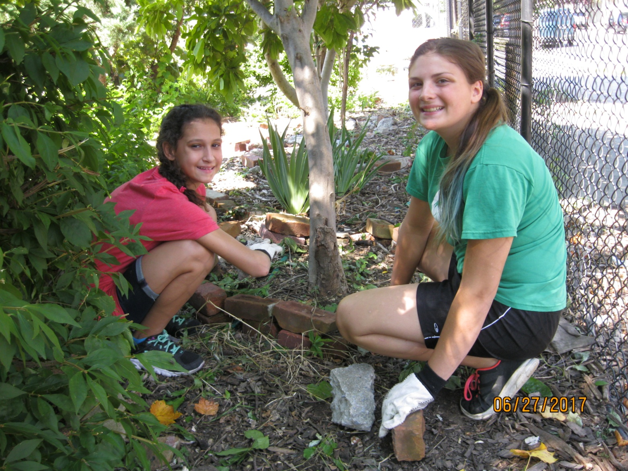

Slide 17
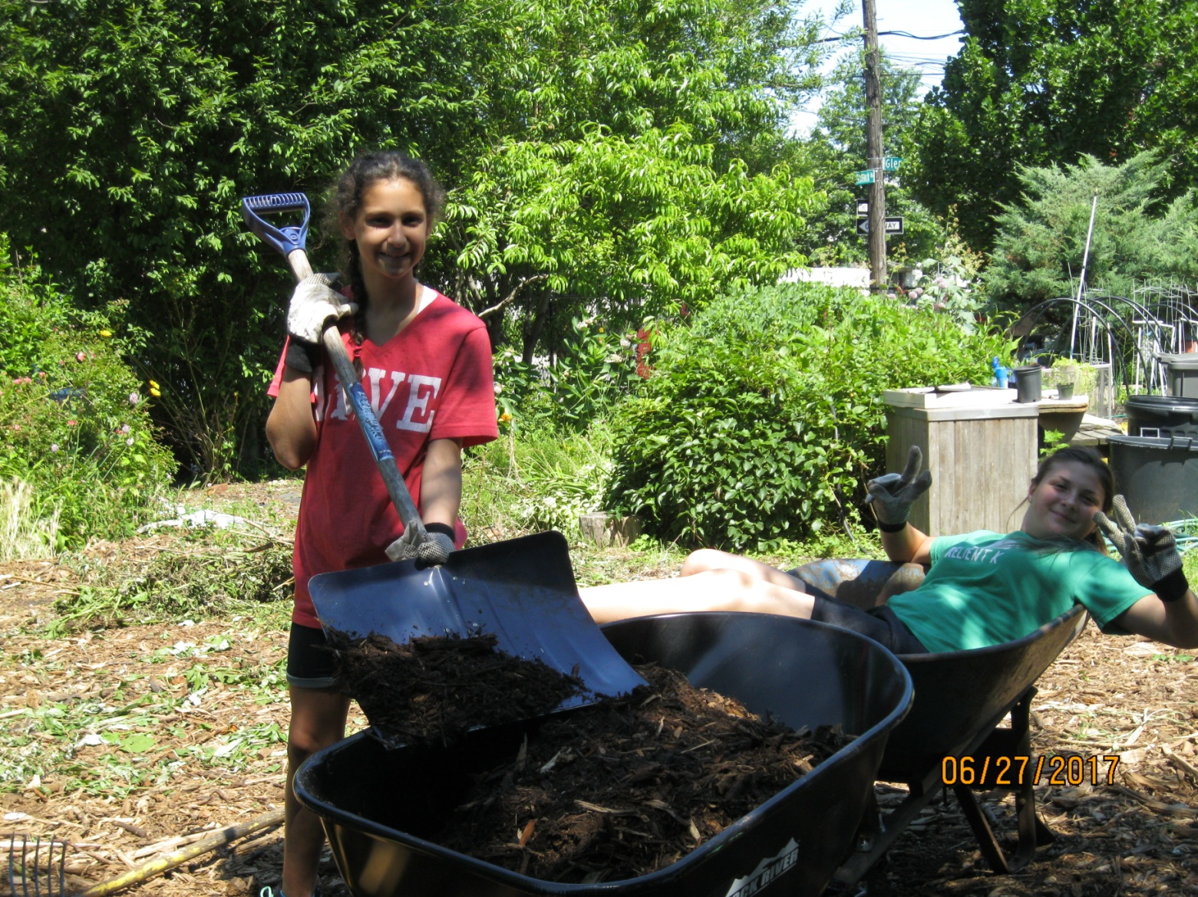

Slide 18
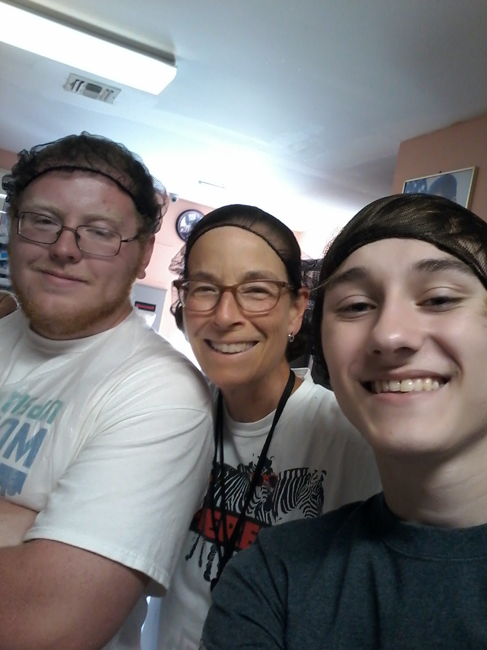
QUEEN LATIFA WORK CREW
Pastor Amy, Shawn and Dom

Slide 19
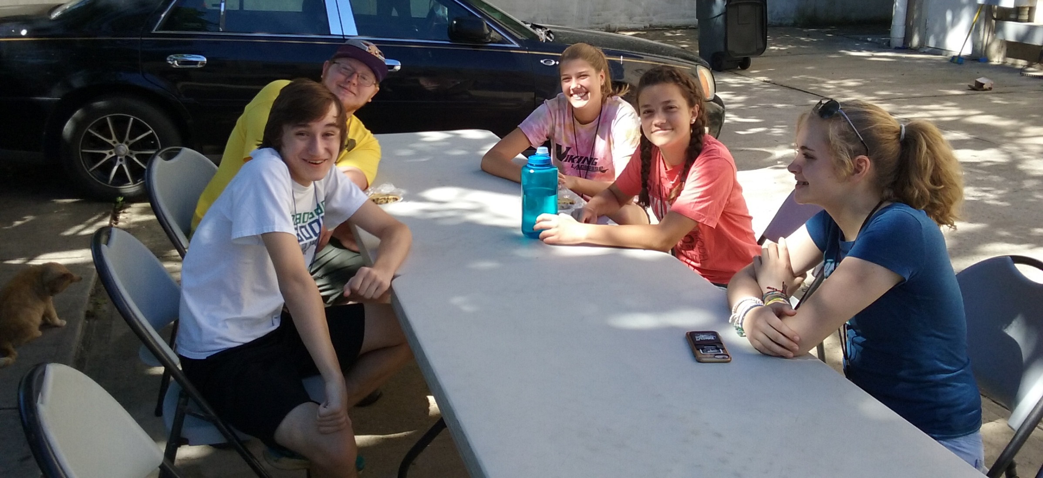
PLUS THREE NEW FRIENDS FROM A CHRIST LUTHERAN CHURCH
IN CONNECTICUT

Slide 20
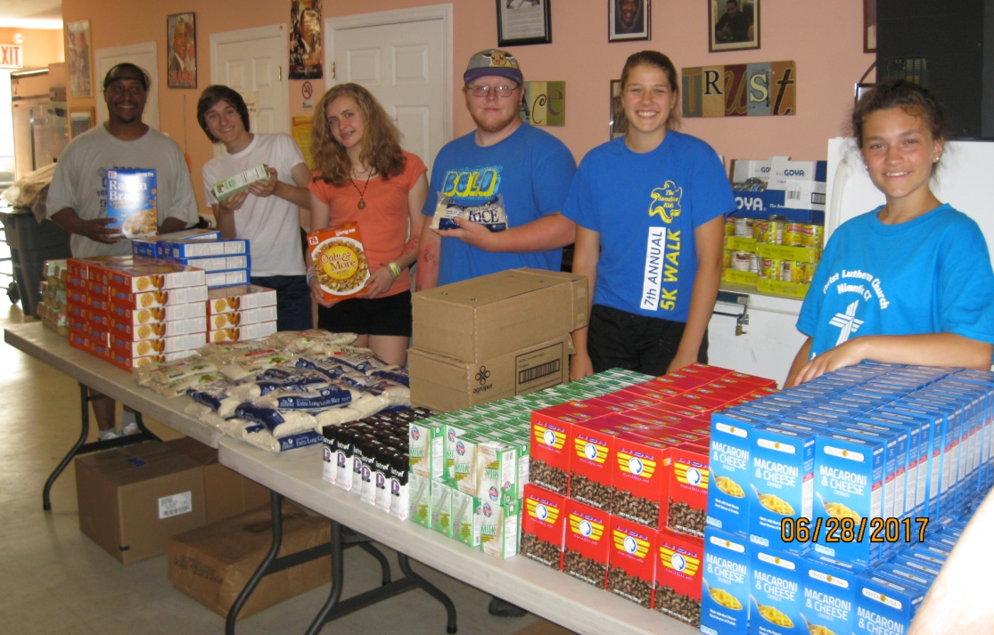
Work at the
United Methodist Pantry & Soup Kitchen
In Rockaway Beach

